Slide 1

Mixed-effects modeling and longitudinal data analysis
Rachel Marcone
Bioinformatics Core Facility, SIB Swiss Institute of Bioinformatics Aug 18, 2021 - Lausanne

Slide 2
Repeated Measures and Longitudinal Data
In repeated measures designs, measurements are taken repeatedly on each individual
When these measurements are taken over time, it is called longitudinal design
Typically various covariates concerning the individuals are recorded
3 types of predictors
Time (or some notion thereof)
Time-variant
Time-invariant
A general goal is to determine how a response depends on the covariates over time
Notes:
Sometimes one wants to predict even a particular outcome overtime
a certain trajectory of an independent variable has a strong association with the outcome, which may lead to a better prediction of this particular outcome. Prediction over time = better stronger association with outcome therefore has as consequence better prediction of the outcome.
Think about growth curves overtime in pediatric service. You should usually have measures at 6 months 1 year 11/2 2 years, but due to parents availability or so you might only be able to make it at 7 months instead of 6 etc. So you can have time which is variant or invariant (for instance for cells one can imagine that 2 h 24h 48h is quite fixed.

Slide 3
Studying Change over Time
Study can be experimental or observational
Data can be collected prospectively or retrospectively
Time can be measured in a variety of units (e.g. weeks, months, years, semesters, sessions, etc.)
Nonetheless, need three or more waves of data
More waves is always better. If your data has only three waves, you must fit simpler models with stricter assumptions (e.g. linear).
Additional waves allow for more flexible models with less restrictive assumptions.
There is nothing sacrosanct about equal spacing. If you expect rapid nonlinear change during some time periods, you should collect more data at those times.
The resultant data need not be balanced. In other words, each person need not have the same number of waves.
Notes:
Sometimes it is not even a notion of time but rather a notion of development or else (youth teenage adulthood for instance, or even embryo fœtus and fully developped )

Slide 4
Traditional Methods have Limitations
Traditional techniques for longitudinal data analysis, such as repeated measures ANOVA, can handle only complete data cases
The assumptions of repeated measures ANOVA, in particular the assumption of sphericity/circularity, are often too restrictive for longitudinal data
Circularity refers to the condition where the variances of the differences between all pairs of within-subject conditions are equal
Departure from circularity results in inflated F-ratios
Far less flexible in handling complex data structures compared to multi-level / mixed-effects modeling
Notes:
Independent and identically distributed variables (“independent observations”).
Normality: the test variables follow a multivariate normal distribution in the population.
Sphericity: the variances of all difference scores among the test variables must be equal in the population.
Mauchly’s test for the sphericity assumption will be included in the output so we'll see if that holds in a minute.

Slide 5
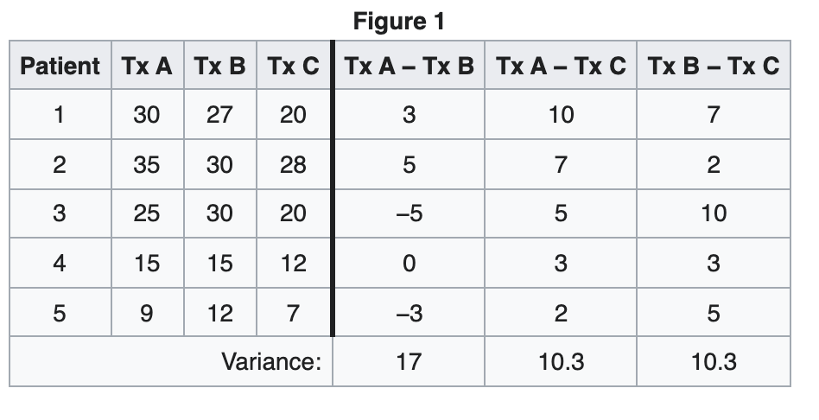
Sphericity explained

Slide 6
Multi-level / Mixed-effects Modeling of Longitudinal Data
The mixed model approach to analyzing longitudinal data was commenced with the paper of Laird and Ware (1982)
Most of the work that has been undertaken to model longitudinal data has been parametric, in the sense that the effects of continuous covariates have been modeled linearly or by using some parametric nonlinear model
An alternative to nonlinear mixed modeling is to incorporate smoothing methods (aka semi-
parametric mixed models)
We’ll come back to this after learning about GAMs

Slide 7
Example #1: Tolerance data set
National Youth Survey (NYS; Raudenbush & Chan 1992)
Participants filled a survey at ages 11, 12, 13, 14, and 15 to provide their tolerance of deviant behavior
Using a 4-point scale, where 1 = very wrong, 2 = wrong, 3 = a little bit wrong, and 4 = not wrong at all, participants indicated whether it was wrong for someone their age to
i.
ii. iii. iv. etc.
Cheat on tests
Purposely destroy property of others Use marijuana
Steal something
Response (i.e. tolerance) was computed as respondent’s average score
Additional covariates
Gender (1=male and 0=female)
Exposure, representing respondent’s self-reported exposure to deviant behavior at age 11, also on a 0-4 scale

Slide 8



Typical Workflow
Import and (if necessary)
restructure data
Exploratory analysis
Multi-level modeling
Hypothesis testing and inference

Slide 9
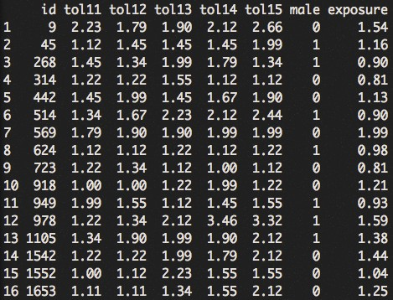
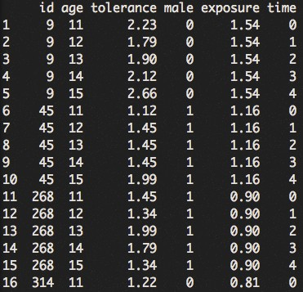














“Tidy datasets are all alike but every untidy dataset is untidy in its own way.” – Hadley Wickham
Wide format
Long format
tidying
variables
observations
values

Slide 10
Typical Workflow
Import and (if necessary)
restructure data
Exploratory analysis
Within-individual change Inter-individual differences in change
Multi-level modeling
Hypothesis testing and inference
9

Slide 11
A Framework for Analyzing Longitudinal Data
Despite the unique set of outcome, predictors, and research questions, each longitudinal study poses an identical pair of questions:
Q1) Within-individual change
How does the outcome change over time?
E.g. how is each individual’s pattern of tolerance over time? Is individual change linear or non-linear? Is it consistent over time or does it fluctuate?
Q2) Inter-individual differences in change
Can we predict differences in these changes?
E.g. do boys and girls experience different patterns of tolerance? Does baseline exposure affect boys and girls in the same way?

Slide 12
A Framework for Analyzing Longitudinal Data
Despite the unique set of outcome, predictors, and research questions, each longitudinal study poses an identical pair of questions:
Q1) Within-individual change
How does the outcome change over time?
E.g. how is each individual’s pattern of tolerance over time? Is individual change linear or non-linear? Is it consistent over time or does it fluctuate?
Q2) Inter-individual differences in change
Can we predict differences in these changes?
E.g. do boys and girls experience different patterns of tolerance? Does baseline exposure affect boys and girls in the same way?

Slide 13

Descriptive Analysis of Individual Change over Time
STEP1: Start with scatterplots (response vs. time) at the individual level Q1
Easier to discern if sets of individuals are plotted on the same panel
Better to use identical axes across individuals
In large data sets, may have to inspect a random subset of individuals
12

Slide 14
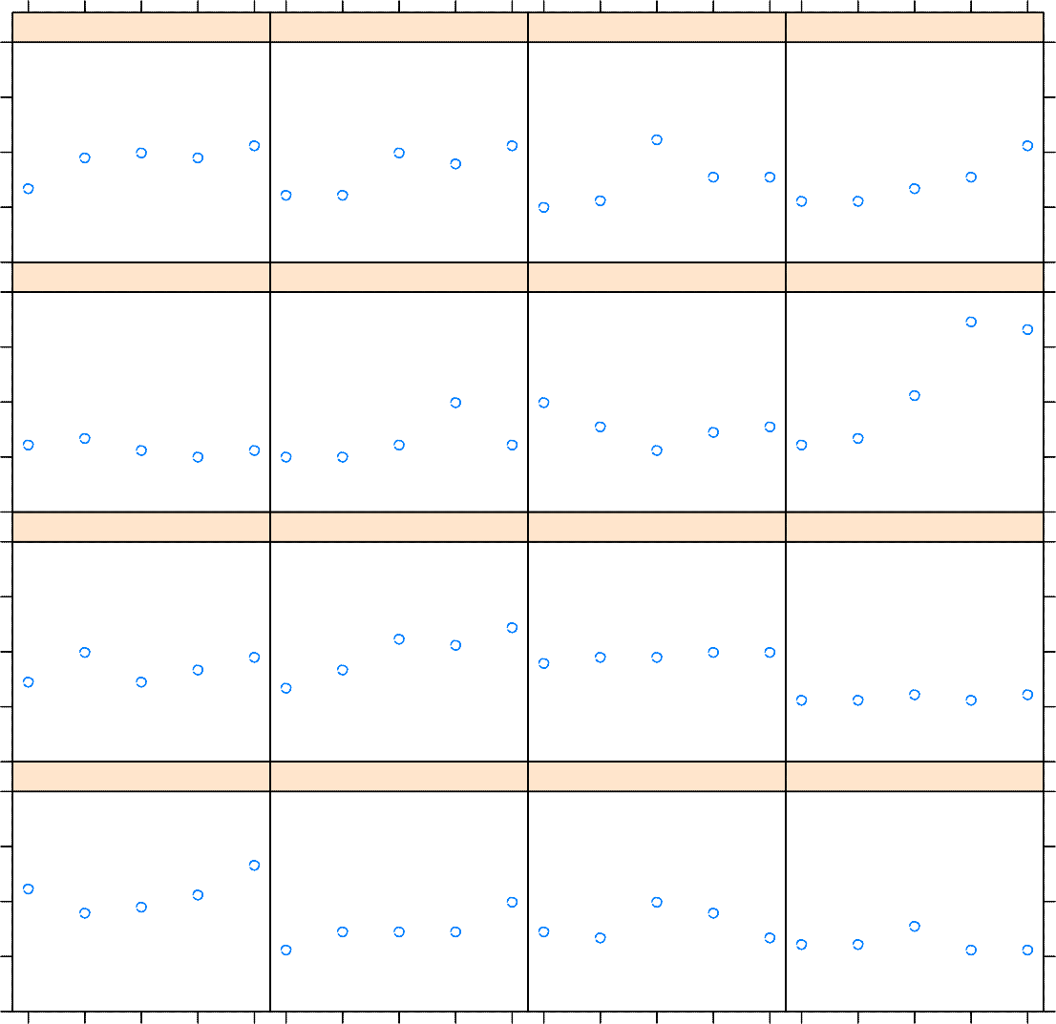
Descriptive Analysis of Individual Change over Time
11 12 13 14 15
11 12 13 14 15
1105
1542
1552
1653
3
2
1
723
918
949
978
3
2
tolerance
1
442
514
569
624
3
2
1
9
45
268
314
3
2
1
11
12
13
14
15
11
age
12
13
14
15

Slide 15
Descriptive Analysis of Individual Change over Time
11 12 13 14 15
11 12 13 14 15
1105
1542
1552
1653
3
2
1
723
918
949
978
Except for
#978,
tolerance generally stays in the lower portion
3
On average the tolerance appears to increase with time
2
tolerance
1
442
514
569
624
3
2
1
9
45
268
314
3
2
1
11
12
13
14
15
11
age
12
13
14
15

Slide 16
Descriptive Analysis of Individual Change over Time
STEP2: Use a trajectory to summarize each person’s temporal pattern of change
Nonparametric approach (e.g. smoothing spline)
Requires no assumptions
Letting the data speak for themselves
Parametric approach (e.g. linear, quadratic, etc.)
Requires assumptions
But instead provides numeric summaries of the trajectories
Exploratory analysis often suggests that different people require different functions
Measurement error makes it difficult to discern if individual patterns are true signal or simply due to random fluctuation
Of course, fitting person-specific models, one individual at a time, is not the most efficient use of longitudinal data; That’s why we will use mixed-effects modeling eventually
15
Notes:
Smoothing spline. One slide more on that .

Slide 17
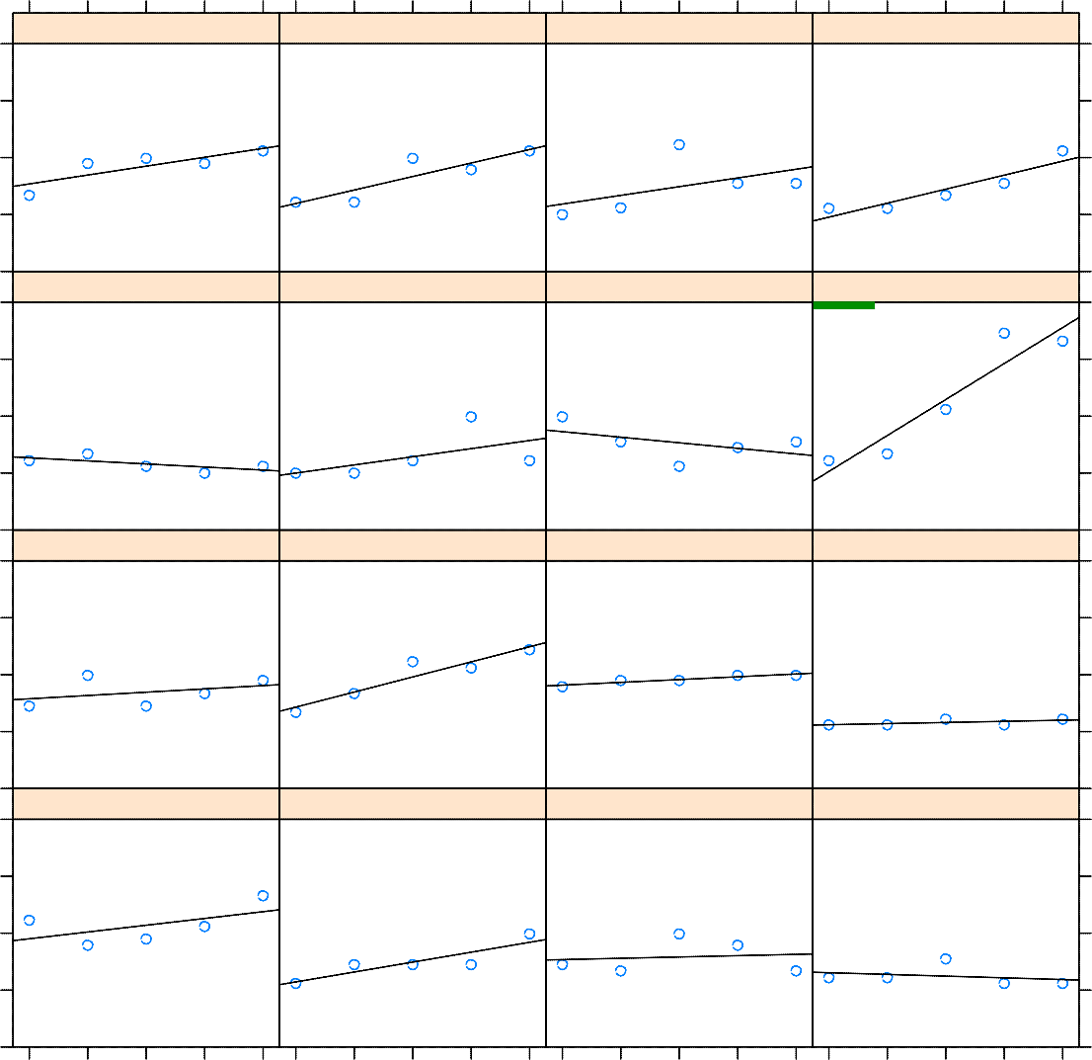
Descriptive Analysis of Individual Change over Time
11 12 13 14 15
11 12 13 14 15
1105
1542
1552
1653
3
2
1
723
918
949
978
intercept = 1.03 slope = 0.63 res.var = 0.17
R² = 0.89
3
2
tolerance
1
linear fit
442
514
569
624
3
2
1
9
45
268
314
3
2
1
11
12
13
14
15
11
age
12
13
14
15

Slide 18
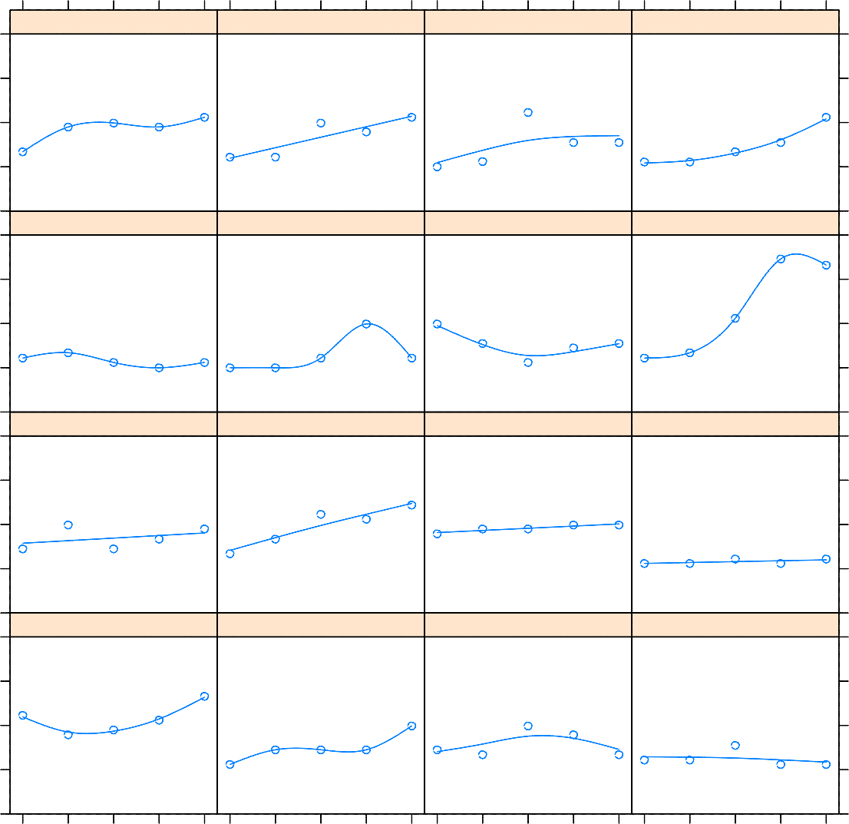
Descriptive Analysis of Individual Change over Time
11 12 13 14 15
11 12 13 14 15
1105
1542
1552
1653
3
2
1
723
918
949
978
3
2
tolerance
1
smoothing spline
442
514
569
624
3
2
1
9
45
268
314
3
2
1
11
12
13
14
15
11
age
12
13
14
15

Slide 19
A Framework for Analyzing Longitudinal Data
Despite the unique set of outcome, predictors, and research questions, each longitudinal study poses an identical pair of questions:
Q1) Within-individual change
How does the outcome change over time?
E.g. how is each individual’s pattern of tolerance over time? Is individual change linear or non-linear? Is it consistent over time or does it fluctuate?
Q2) Inter-individual differences in change
Can we predict differences in these changes?
E.g. do boys and girls experience different patterns of tolerance? Does baseline exposure affect boys and girls in the same way?
18

Slide 20

Exploring Differences in Change across People
Does everyone change in the same way, or do the trajectories of change differ substantially across people? Q2
STEP3: Plot, on a single graph, the entire set of individual trajectories, and compute an average change trajectory
Discretize time on a reasonably refined grid
Estimate individual trajectories on the grid
Average individual estimates for each point on the grid
Apply the same smoothing algorithm, nonparametric or parametric, used to obtain individual trajectories
NEVER infer the shape of the individual change trajectories from the shape of their averages
The only kind of trajectories for which the “average of the curves” is identical to the “curve of the averages” is one whose mathematical representation is linear in the parameters [Keats 1983]
We examine the averages simply for comparison, not to learn anything about
the underlying shapes of the individual trajectories
19
Notes:
linear in the parameters [Keats 1983]

Slide 21
Exploring Differences in Change across People
nonparametric
parametric
4
4
3
3
tolerance
tolerance
2
2
1
1
0
0
11 | 12 | 13 | 14 | 15 | 11 | 12 | 13 | 14 | 15
 |  | age |  |  |  |  | age

Slide 22
Exploring Differences in Change across People
STEP4: Use the results of exploratory analysis to (re-)frame questions about change
Adopting a parametric model for individual change allows us to express generic questions about inter-individual differences in change as specific questions about the parameters of the model
E.g. in the case of linear fit, it is often helpful to examine
Sample means of the estimated intercepts and slopes
Sample variances (or SD) of the estimated intercepts and slopes
Sample correlation between the estimated intercepts and slopes
 | intercept | slope
mean | 1.36 | 0.13
SD | 0.30 | 0.17
Bivariate corr |  | -0.45

Slide 23
Exploring Differences in Change across People
STEP5: Explore the relationship between change and time-invariant predictors
Allows us to uncover systematic patterns in the individual change trajectories corresponding to inter-individual variation observed in personal trajectories, e.g.
Examining differences by gender allows us to assess
Whether boys or girls are initially more tolerant of deviant behavior
Whether boys and girls tend to have different annual rates of change
Examining differences by baseline exposure allows us to assess
Whether a child’ initial level of tolerance is associated with baseline exposure
Whether a child’ rate of change in tolerance is associated with baseline exposure
– If a predictor is continuous you can temporarily categorize it

Slide 24
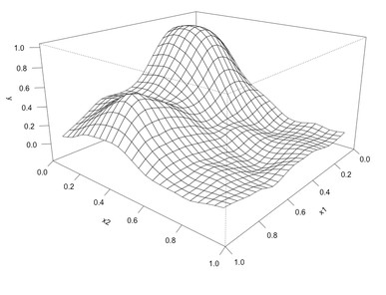
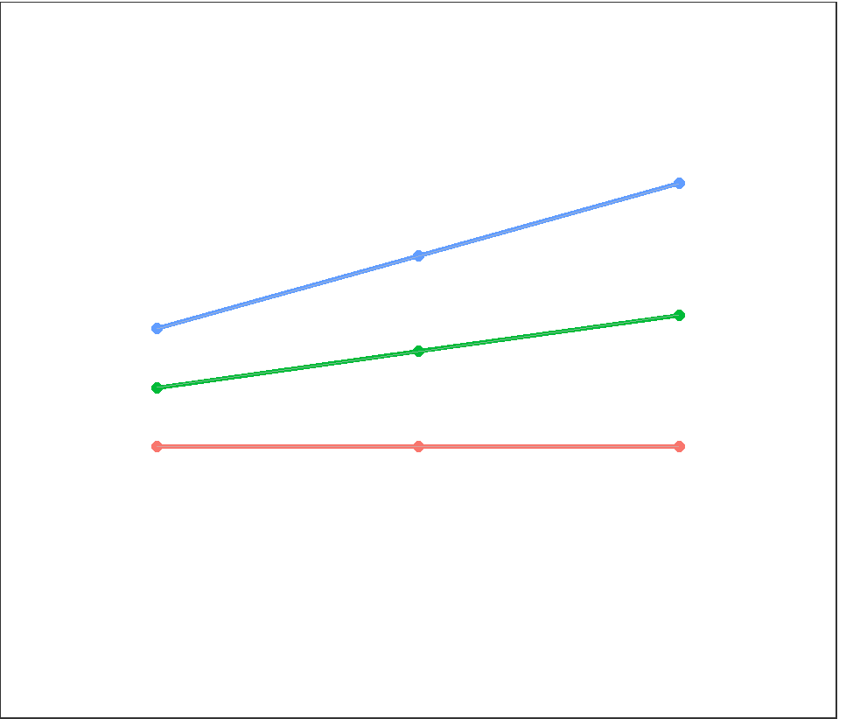

Exploring Differences in Change across People
What about time-variant predictors?
– For example via loess (with multiple predictors) or thin plate splines (from mgcv). See persp() in base R graphics for plotting 3D surfaces.
– Another approach is “simple slope analysis”
1SD above mean mean
1SD below mean
response
Time-variant predictor
23
time
Notes:
One slide loess one thin plate splines to be added mgcv

Slide 25
LOESS
Stands for locally estimated scatterplot smoothing
Non parametric
Combines multiple regression models in a K-nearest neighbor based meta-model

Slide 26
Thin Plate splines
Thin plate splines (TPS) are a technique for data interpolation and smoothing.
Advantages :
It produces smooth surfaces, which are infinitely differentiable.
There are no free parameters that need manual tuning.
It has closed-form solutions for both warping and parameter estimation.
There is a physical explanation for its energy function.

Slide 27
Exploring Differences in Change across People
males females
4
4
3
3
tolerance
tolerance
2
2
1
1
0
0
11
12
13
14
15
11
12
13
14
15
age
age
24
low−exposure
high−exposure
4
4
3
3
tolerance
tolerance
2
2
1
1
0
0
11
12
13
14
15
11
12
13
14
15
age
age

Slide 28
Typical Workflow
Import and (if necessary)
restructure data
Exploratory analysis
Within-individual change Inter-individual differences in change
Multi-level modeling
Hypothesis testing and inference

Slide 29
Exercises
Tolerance.R -> Open and Follow the instruction
Corrections in a few…

Slide 30
Mixed Models
Mixed-effects models provide a flexible and powerful tool for the analysis of grouped data, including:
• blocked designs
• repeated measures (each subject measured for each condition; individuals are `blocks')
• Longitudinal data (measures repeated over time)
• multilevel data

Slide 31

Mixed Models
Offer flexibility in modeling within-group correlation often present in grouped data
• Handle balanced and unbalanced data in a unified
framework
• There is reliable, efficient software for fitting
They are characterized by statistical models containing fixed and random effects.
Usually represented by the following formula

Slide 32
Mixed Modeling: ML vs. REML
Choice of methods for parameter estimation/prediction
Maximum Likelihood (ML)
Restricted Maximum Likelihood (REML)
The general wisdom is that
ML produces more accurate estimates of the fixed parameters, whereas REML produces more accurate predictions of random variances
Therefore, the choice depends on whether the hypotheses are focused on the fixed parameters or random variances
In practice, the choice of ML or REML will make only small differences to the parameters
If you want to compare models, you MUST use ML

Slide 33
Mixed Modeling: Model Selection
Assessing the fit and comparing multi-level models
Likelihood ratio test based on ML theory
R reports the log-likelihood (LL)
Essentially the smaller the value of LL the better
R also produces two adjusted LL values, which can be interpreted in a similar manner
AIC: Akaike’s Information Criterion
A goodness of fit measure corrected for model complexity
BIC: Bayesian Information Criterion
Comparable to AIC but slightly more conservative (i.e. it corrects more harshly for the number of parameters)
Neither AIC or BIC are intrinsically interpretable; they are only useful in comparing models. Smaller values in both cases mean a better-fitting model
Recommended approach: start simple!
28

Slide 34
Multi-level Modeling Approach to Longitudinal Data
A key assumption of standard linear regression is the assumption of independently distributed error terms for the individual observations within a sample
Essentially means that there are no relationships among individual observations for the dependent variable once the independent variables are accounted for
In real world, data often has a hierarchical structure, hence the name “multi-level”
It simply means that some variables are clustered or
nested within other variables
In longitudinal design, this hierarchy (in part) stems from repeated measures obtained from the same individual over time

Slide 35
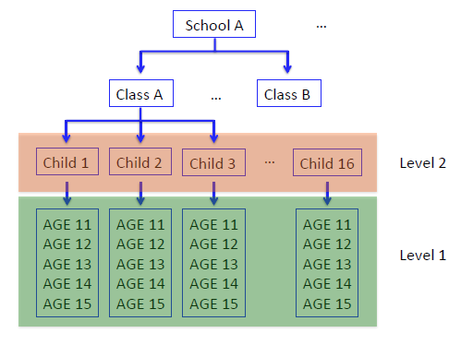
Multi-level Modeling Approach to Longitudinal Data

Slide 36
Multi-level Modeling Approach to Longitudinal Data
When dealing with multi-level data, the assumption of independent errors is violated
i.e. the potential inter-individual correlation (correlation among repeated measures obtained from the same individual) may result in inappropriate estimate of model parameters
Moreover, by ignoring multi-level structure of data we may miss important relationships involving each level in the data
Solution: When data has multi-level structure, we allow the parameters of the model to vary between clusters
Fixed vs. random coefficients (mixed-effects modeling)
Packages for multi-level modeling in R
nlme (allows for flexible modeling of the covariance structure)
lme4

Slide 37
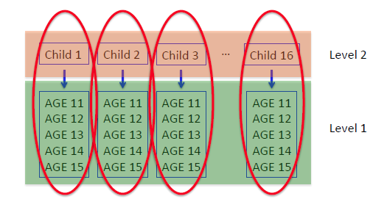
Multi-level Modeling Approach to Longitudinal Data
Allowing the parameters of the model to vary between clusters:
Either allowing the intercepts to vary among children, or allowing the slopes to vary among children,
or allowing both intercepts and slopes to vary among children.
Instead of estimating 16 intercepts and 16 slopes, we will estimate one fixed intercept, one fixed slope, one random intercept and one random slope.

Slide 38
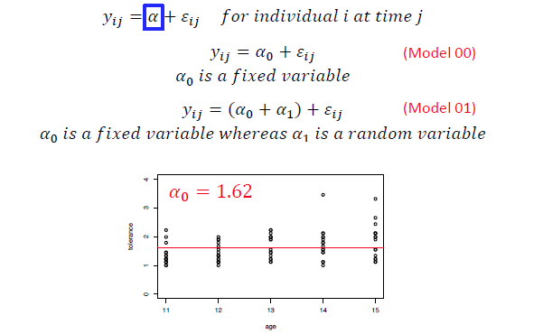

Multi-level Modeling Approach to Longitudinal Data

Slide 39
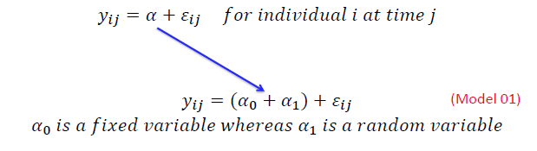
Multi-level Modeling Approach to Longitudinal Data
4
Individual
#978
3
tolerance
2
1
0
11
12
13
14
15
age

Slide 40
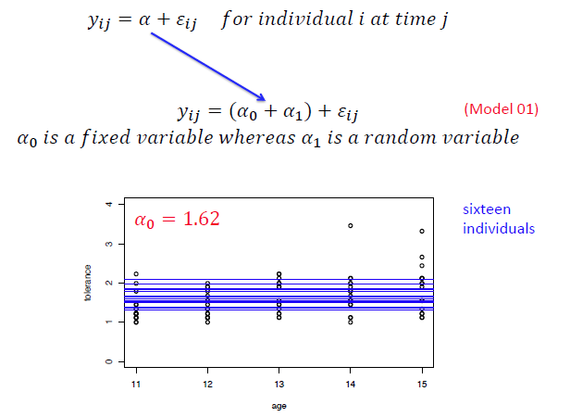
Multi-level Modeling Approach to Longitudinal Data

Slide 41
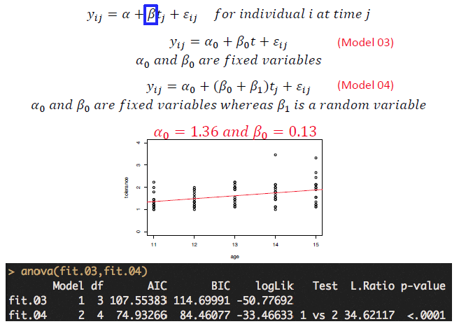
Multi-level Modeling Approach to Longitudinal Data

Slide 42
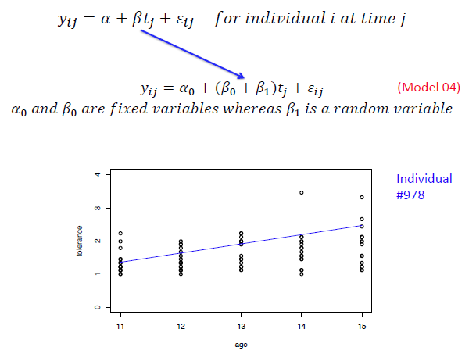
Multi-level Modeling Approach to Longitudinal Data

Slide 43
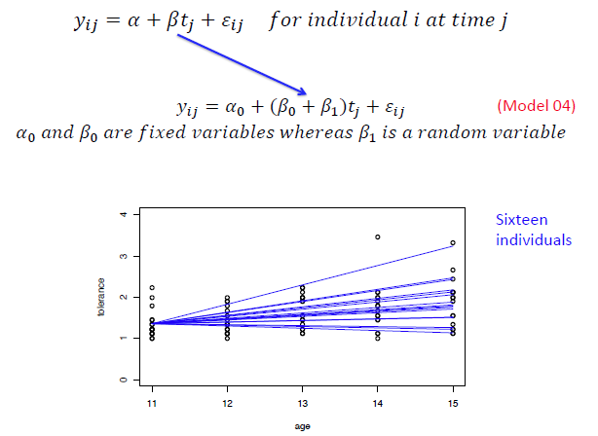
Multi-level Modeling Approach to Longitudinal Data

Slide 44
Summary of a Typical Workflow
Import and (if necessary)
restructure data
Exploratory analysis
Within-individual change Inter-individual differences in change
Multi-level modeling
Hypothesis testing and inference

Slide 45

Multi-level Modeling Approach to Longitudinal Data
Assumptions about the covariance structure of the data
Variance components
Diagonal
AR(1): typically used when data is measured over time
corAR1(…)
corCAR1(…)
corARMA(…)
Unstructured

Slide 46
Working Exercises in R
#1: Corn Data
#2: Tolerance2.R
#3: Rat_Brain.R
#4: “Beat the Blues” clinical trial Beat_the_Blues.R
#5: Bone_mineral_density.R

